Slide 1
(CPDD 77th Annual Scientific Meeting) 2015 Travel Award Recipients

Slide 2
Congratulations to the
2015 CPDD Early Career Investigator Awardees!

Slide 3
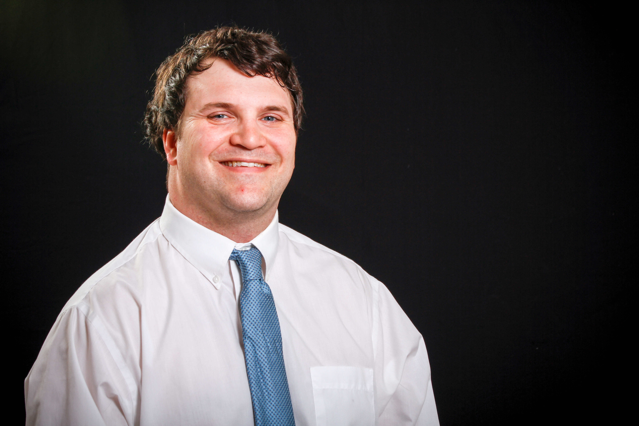
A. George Wilson, PhD
University of Kentucky
Your Photo

Slide 4
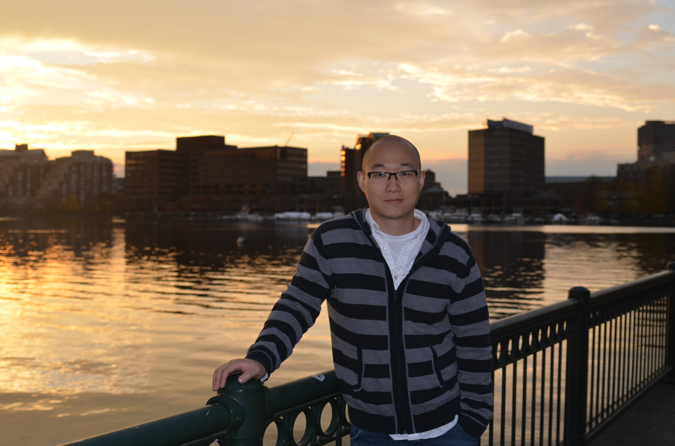
Yue Pan
University of Miami

Slide 5
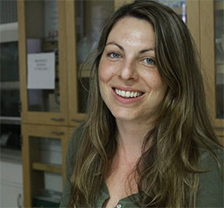
Stephanie M. Groman, PhD
Yale University

Slide 6
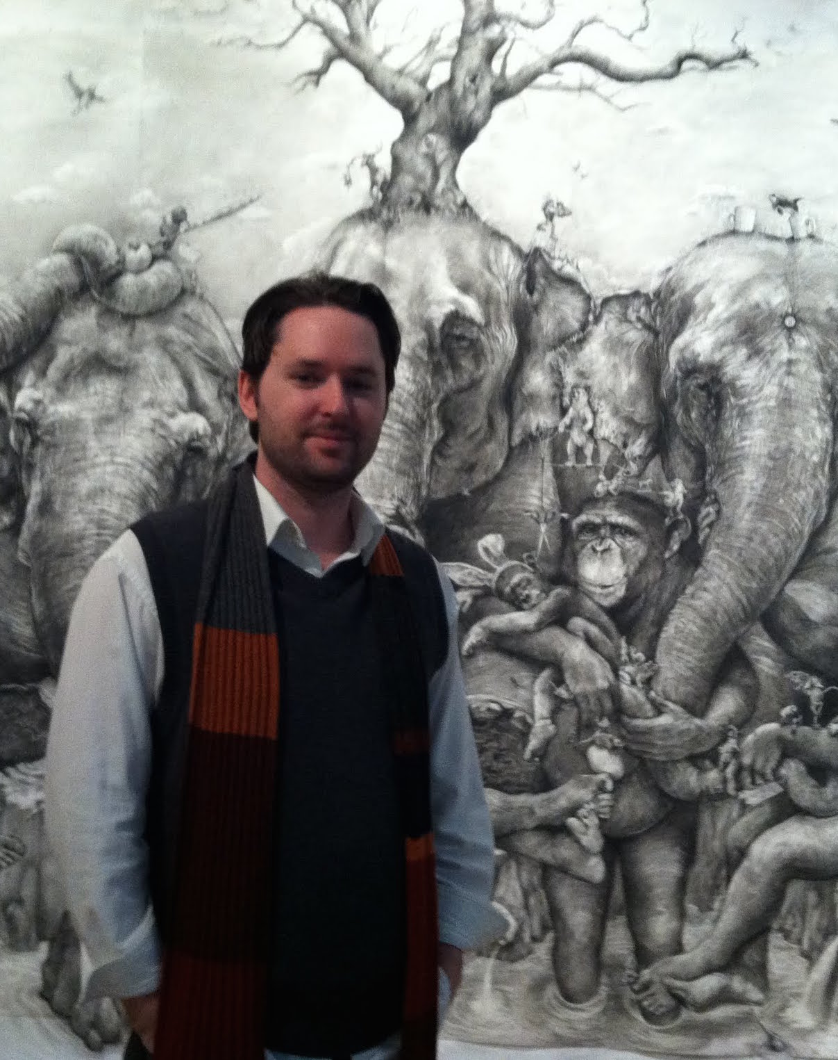
Brian J. Fairman, PhD
Johns Hopkins Bloomberg School of Public Health
Your Photo

Slide 7
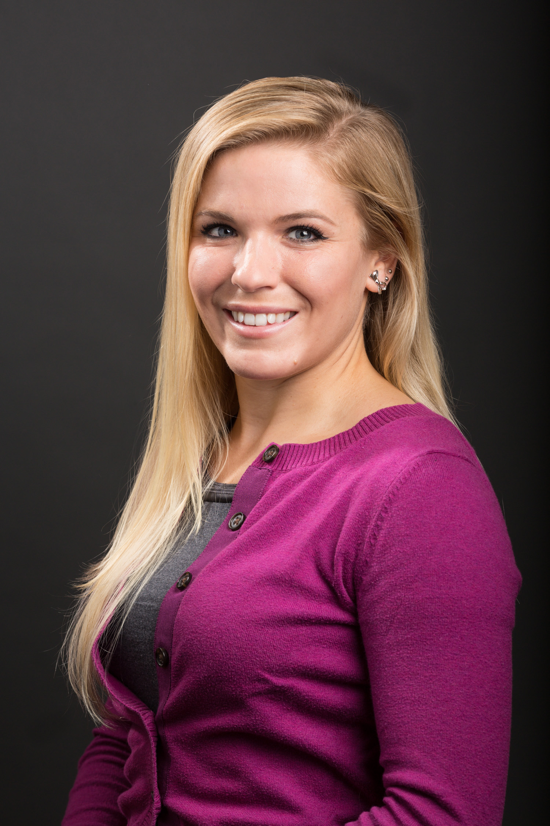
Marci Mitchell, PhD
Yale University

Slide 8
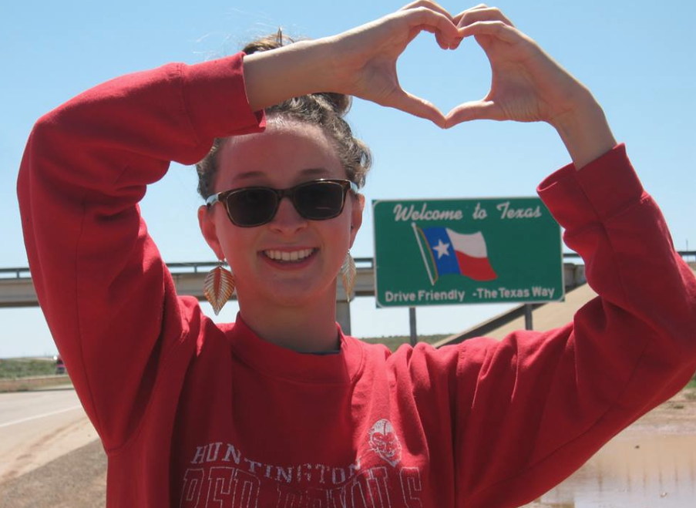
Lorra Garey
University of Houston
Your Photo

Slide 9
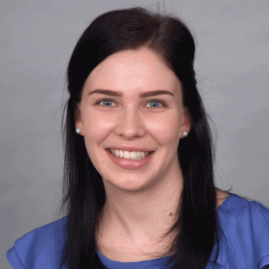
Elizabeth Whittaker
National Drug and Alcohol Research Centre, UNSW

Slide 10
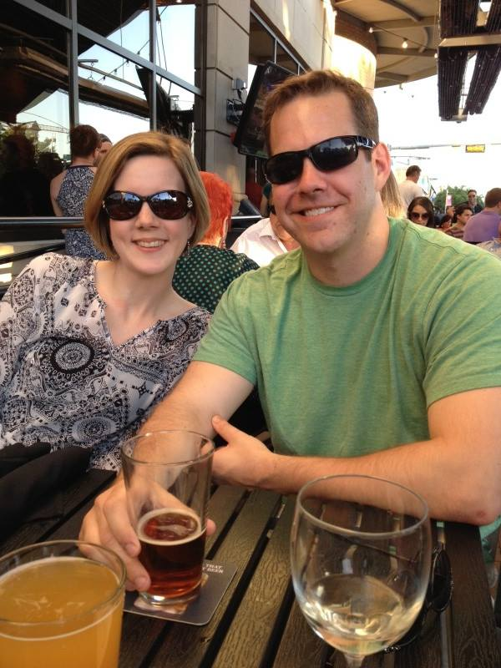
Ryan Gregg
Temple University
School of Medicine

Slide 11
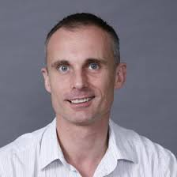
Edmund Silins, PhD
National Drug & Alcohol Research Centre; UNSW Australia
Your Photo

Slide 12
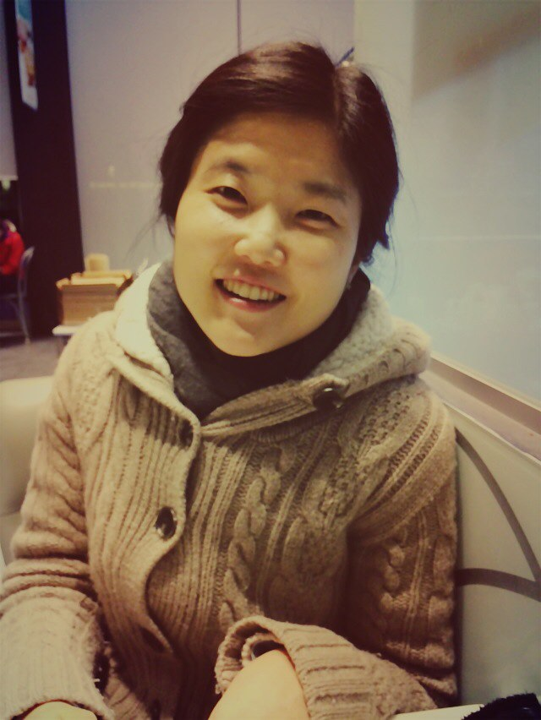
Min-Jeong Yang
Rutgers University
Your Photo

Slide 13
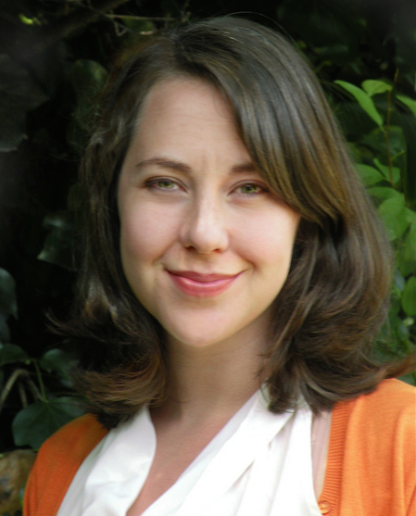
Abigail Batchelder, PhD, MPH
University of California, San Francisco

Slide 14
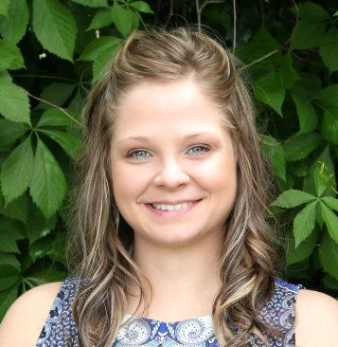
Sally L. Huskinson, PhD
University of Mississippi Medical Center
Your Photo

Slide 15
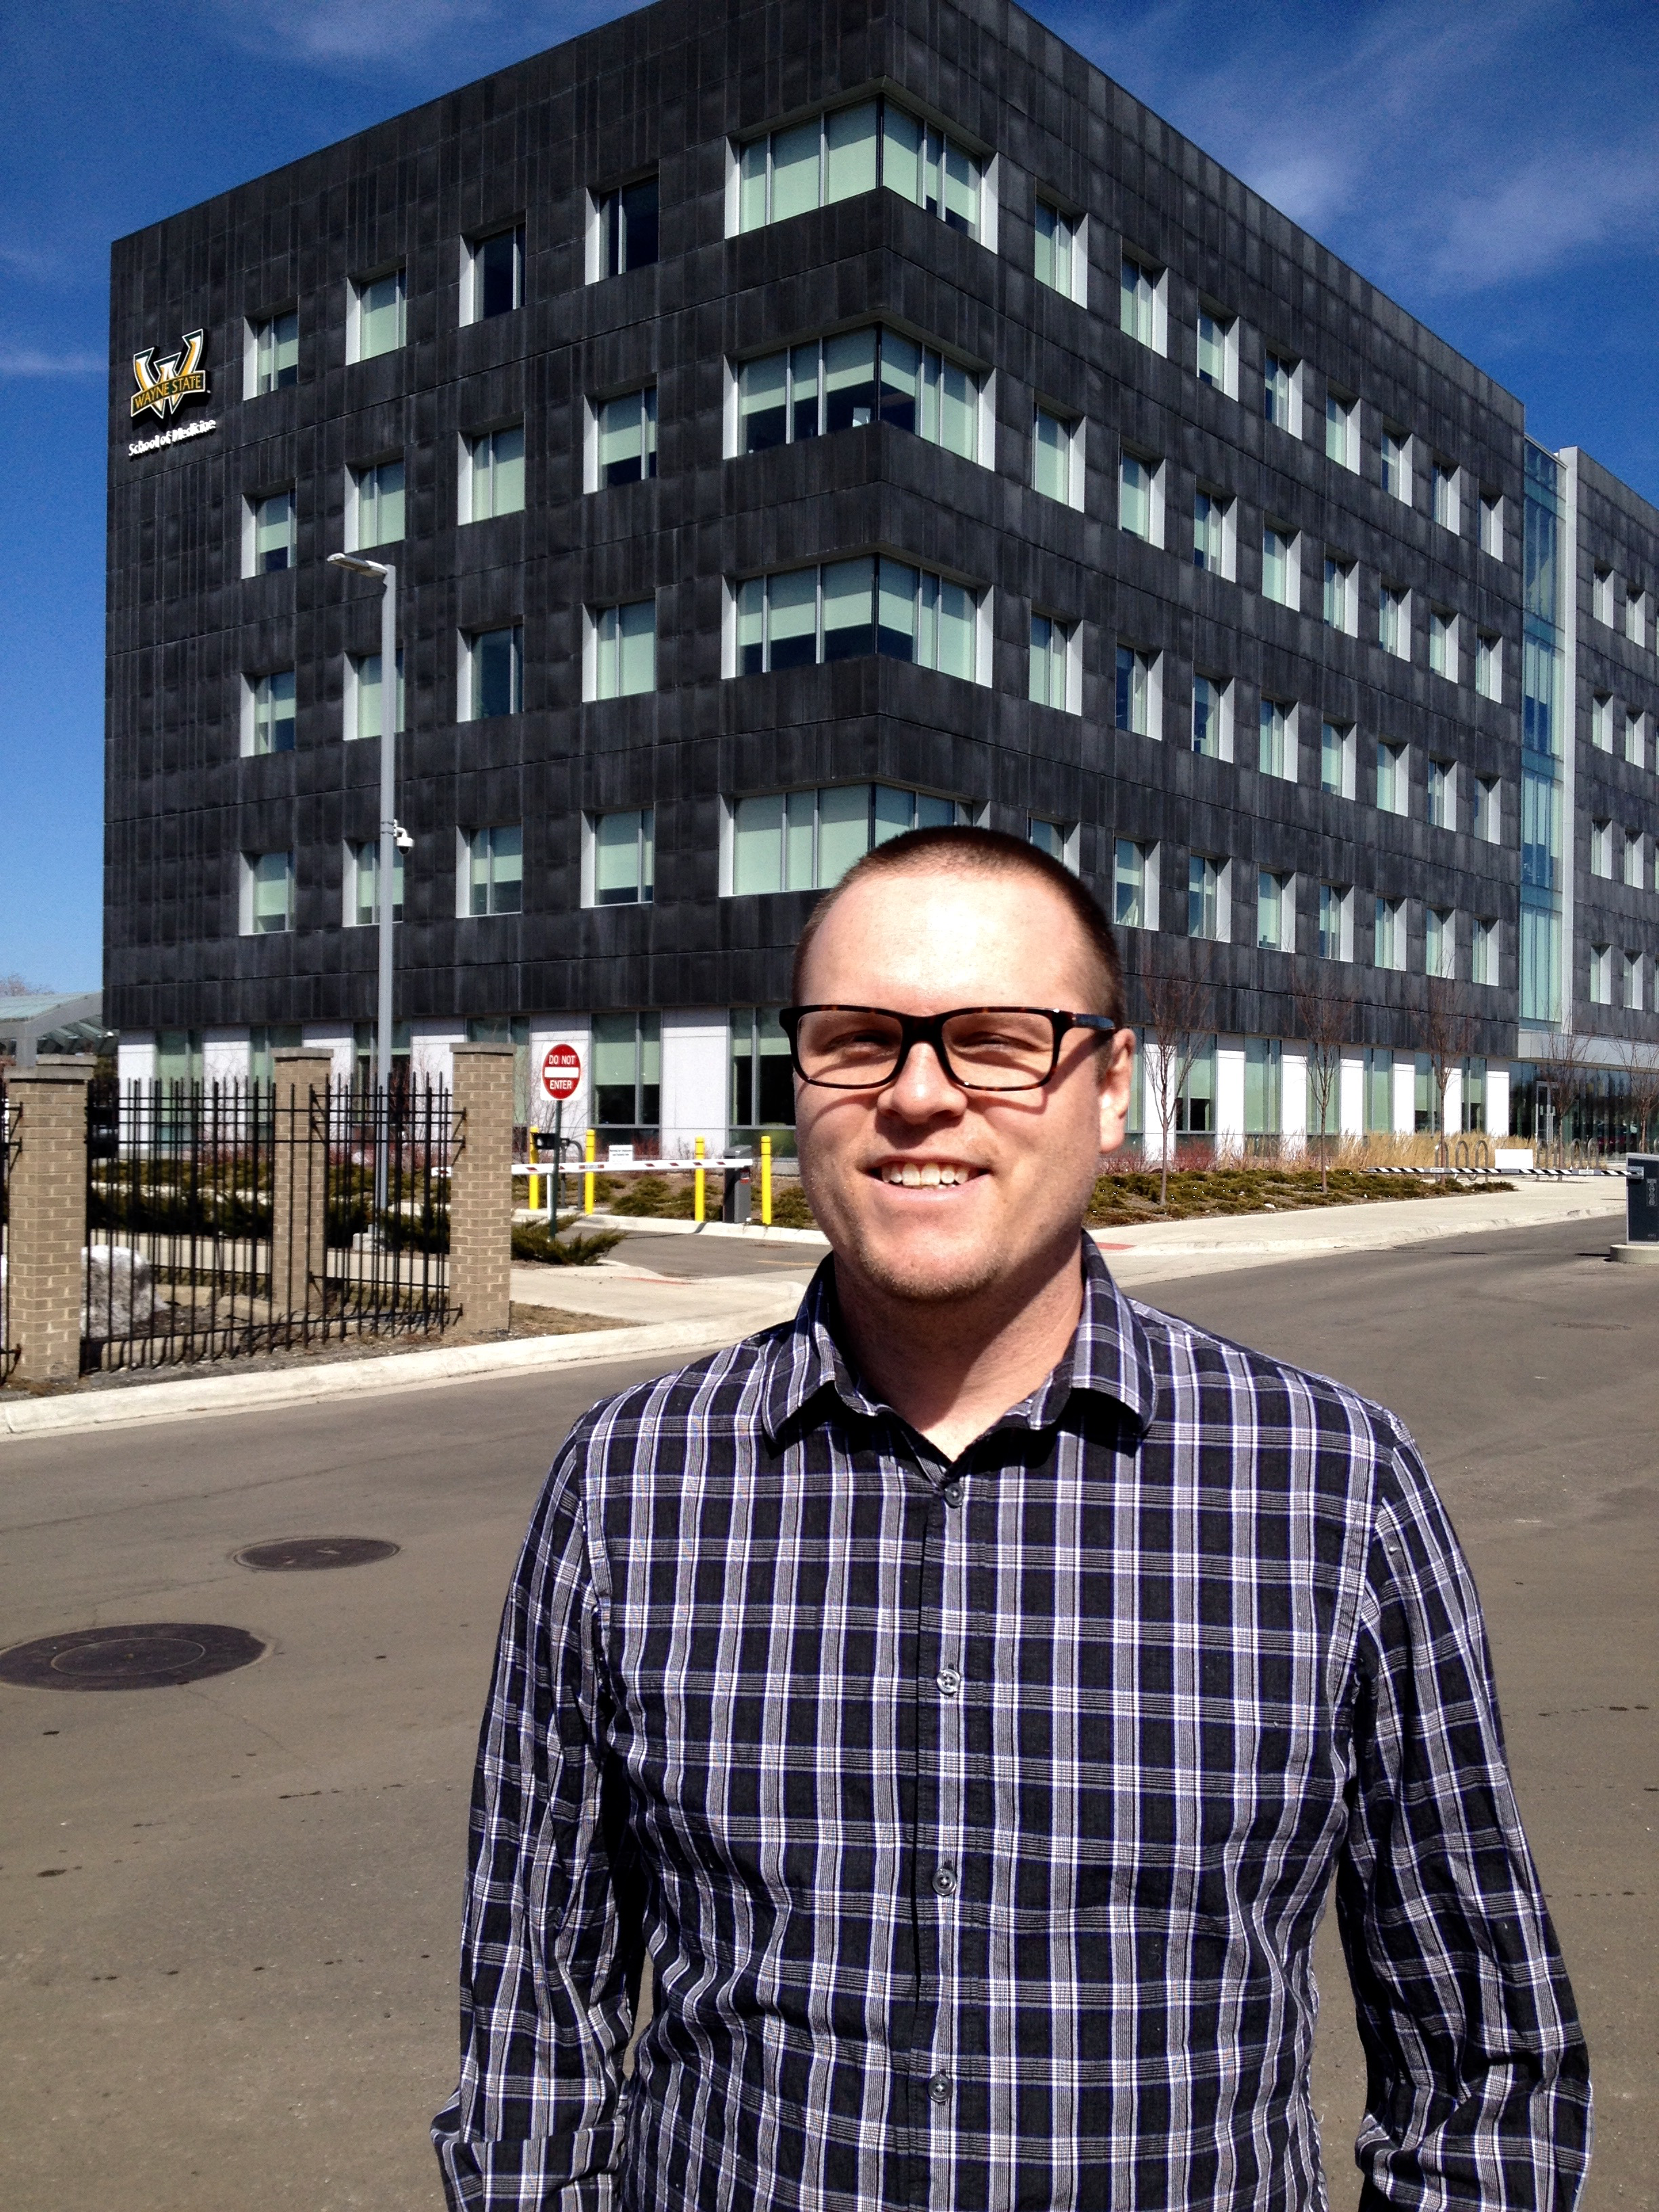
Jamey J. Lister, PhD
Wayne State University
Your Photo

Slide 16
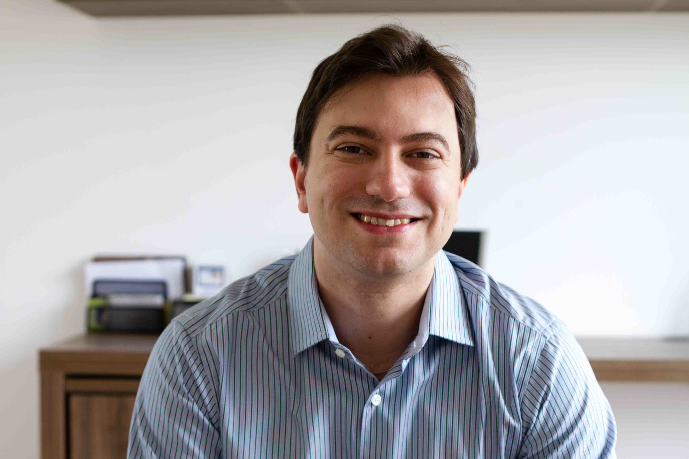
João Mauricio Castaldelli-Maia, MD
University of São Paulo

Slide 17
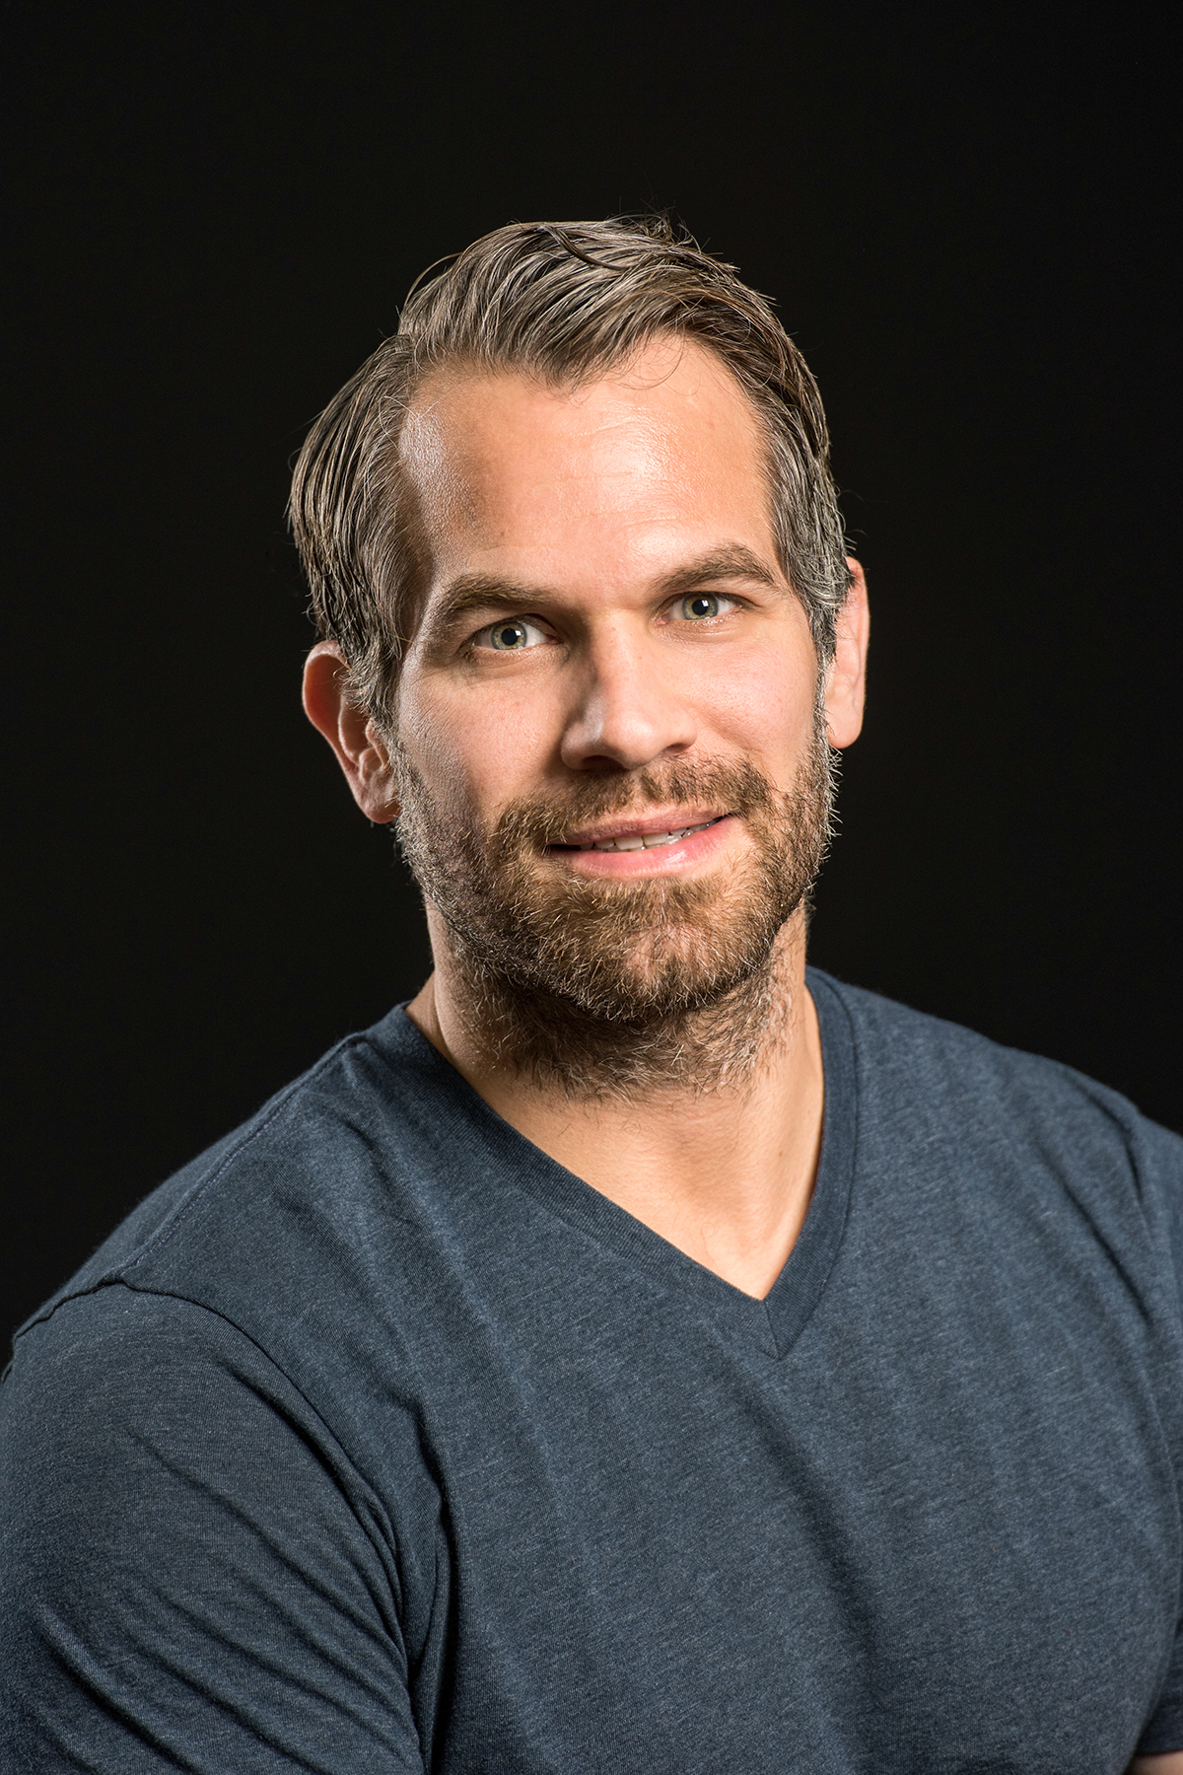
Philip Veliz, PhD
University of Michigan

Slide 18
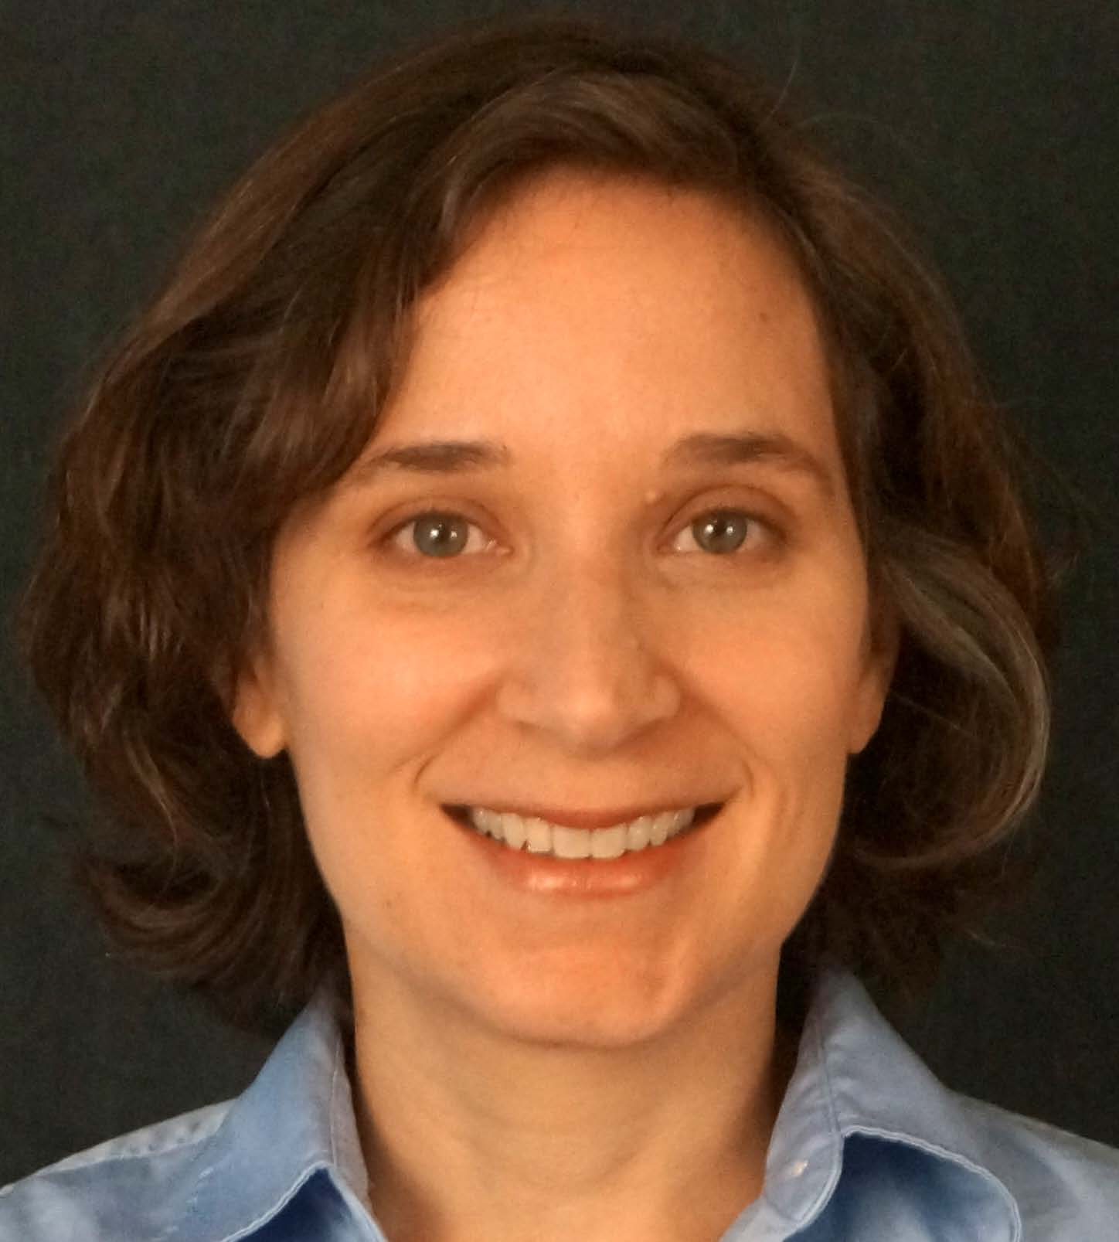
Annesa Flentje, PhD
University of California,
San Francisco

Slide 19
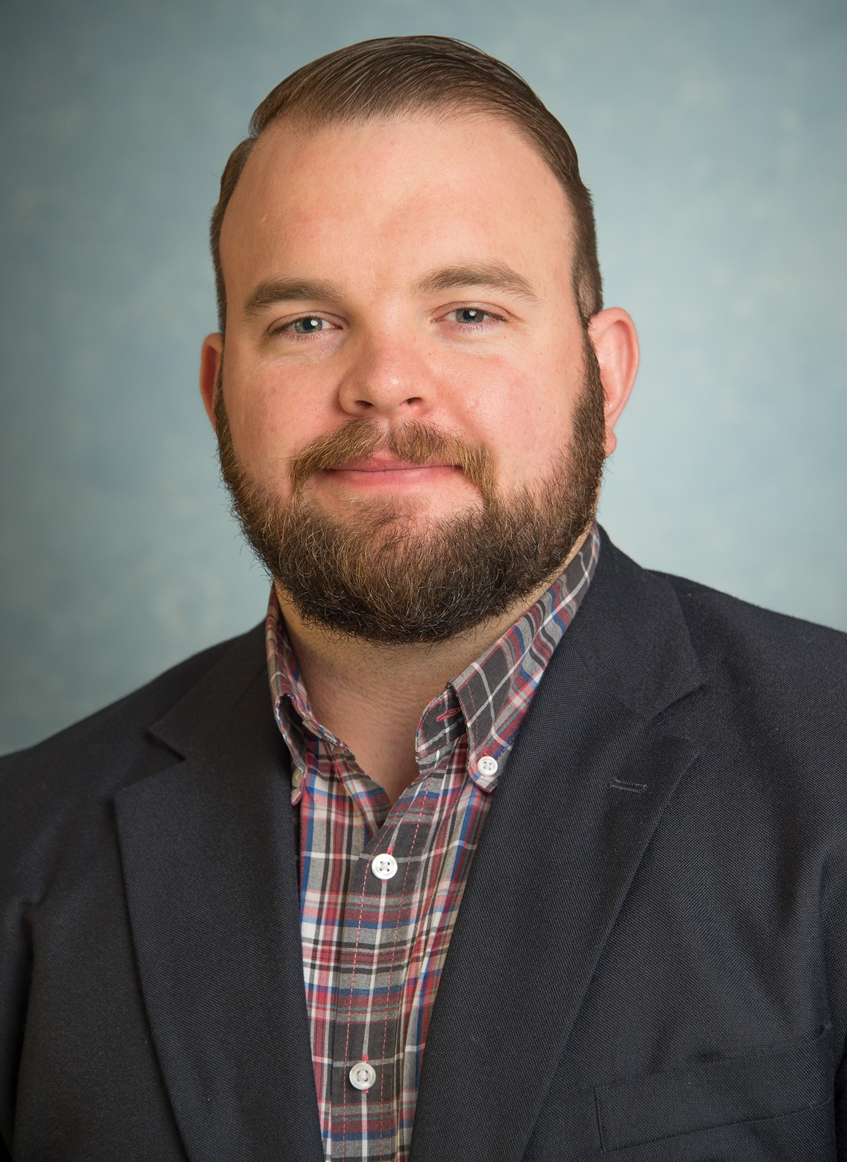
Ryan T. Lacy, PhD
Davidson College

Slide 20
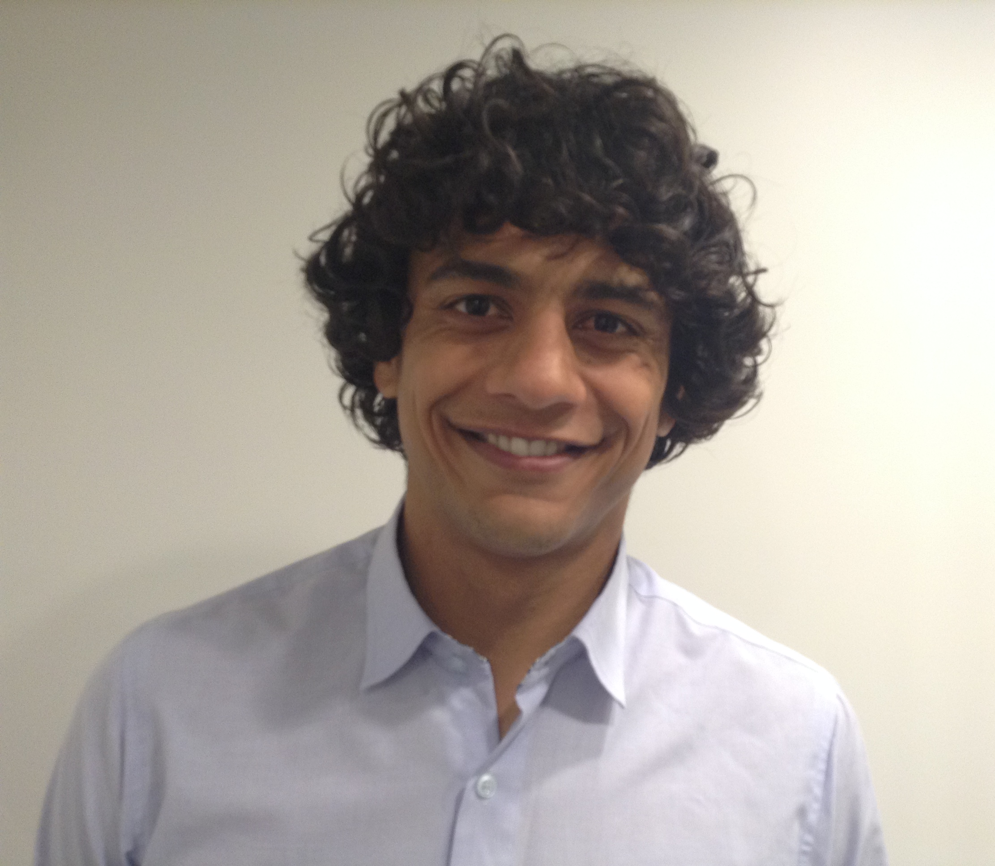
Dane Aronsen
Victoria University of Wellington

Slide 21
Lauren DePoy
Emory University
Your Photo
Notes:
r

Slide 22
Amy Peacock, PhD
University of Tasmania
Notes:
r

Slide 23
Congratulations to the 2015 Stephen G. Holtzman
Travel Award Recipient!

Slide 24
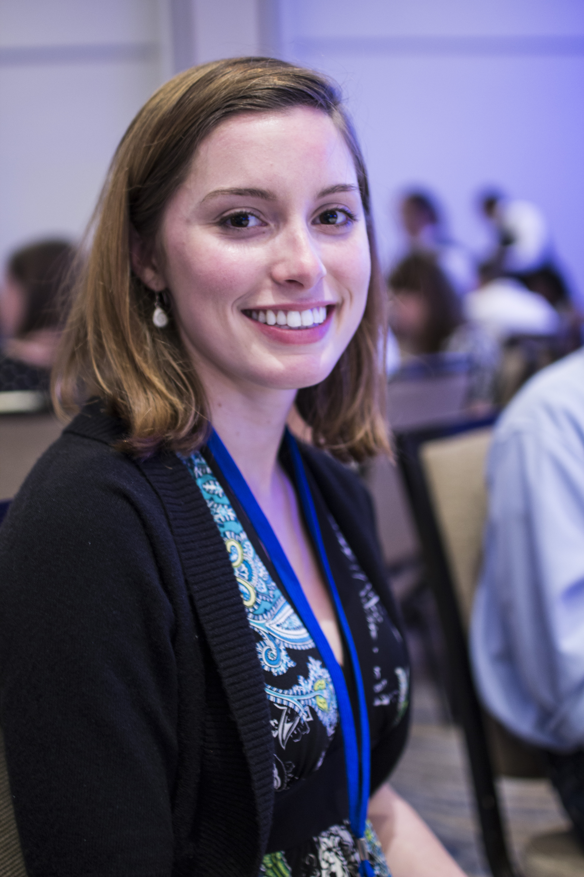
Chloe Jordan
Boston University
Notes:
r

Slide 25
Primm-Singleton Travel Awardees 2015

Slide 26
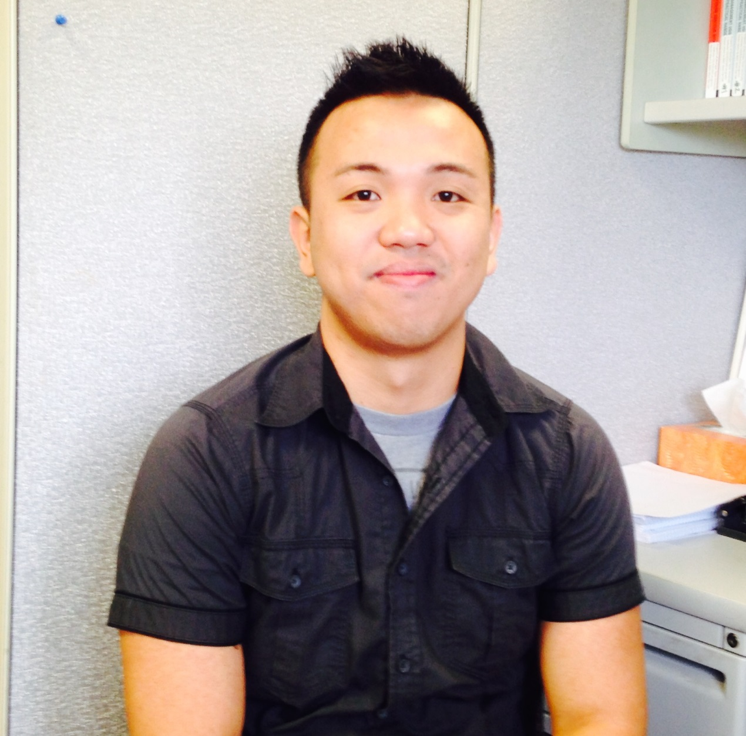
Karl Christian Alcover Michigan State University

Slide 27
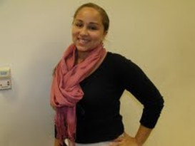
Caravella McCuistian University of Cincinnati

Slide 28
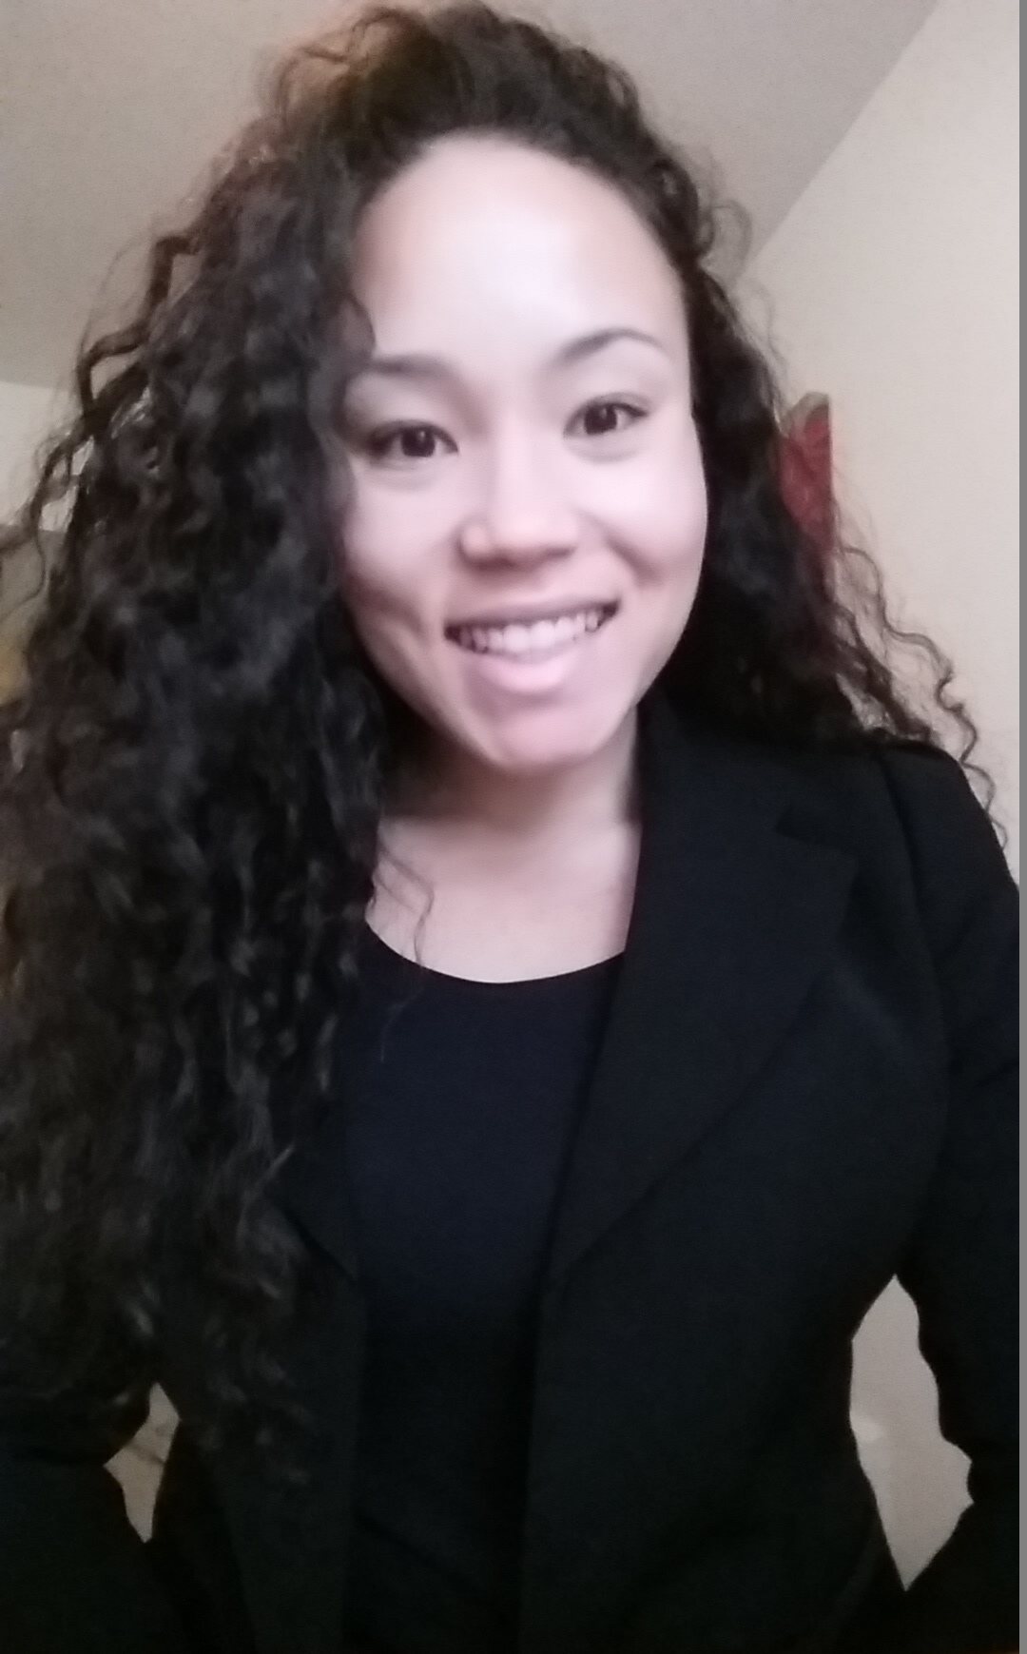
Holly H. Reid Wayne State University

Slide 29
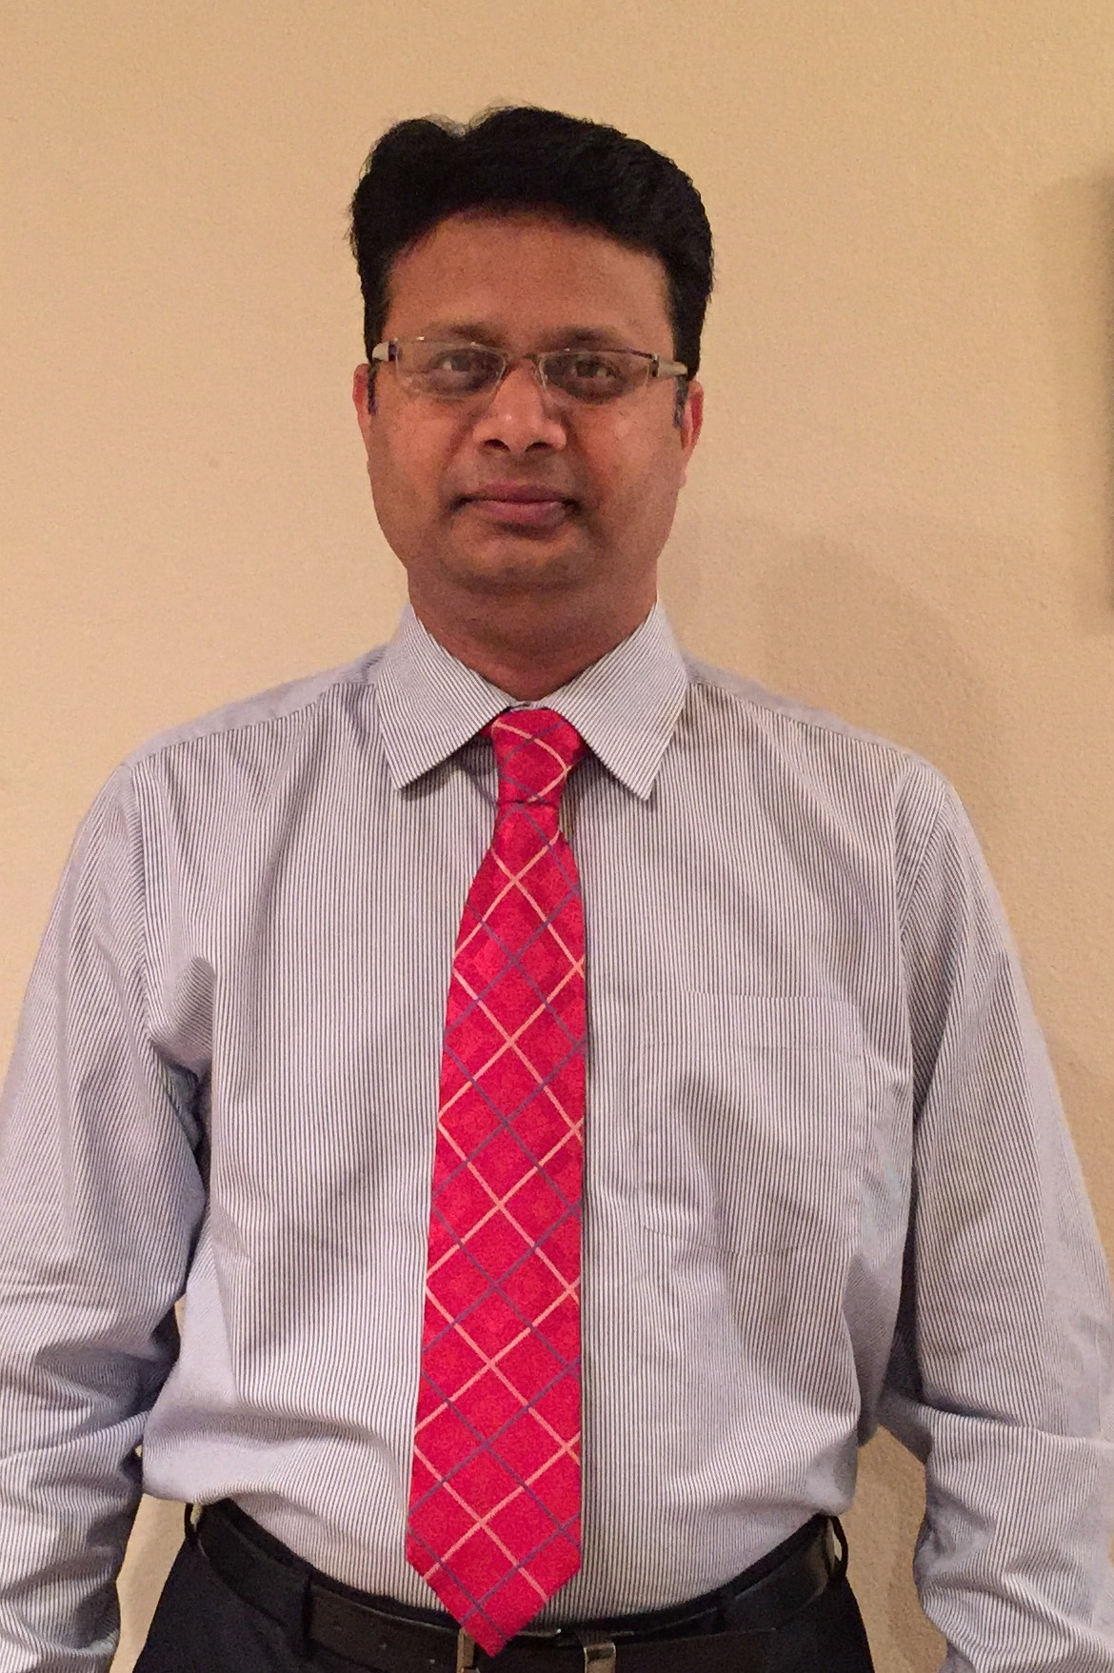
Nilesh S. Tannu University of Texas Medical School at Houston

Slide 30
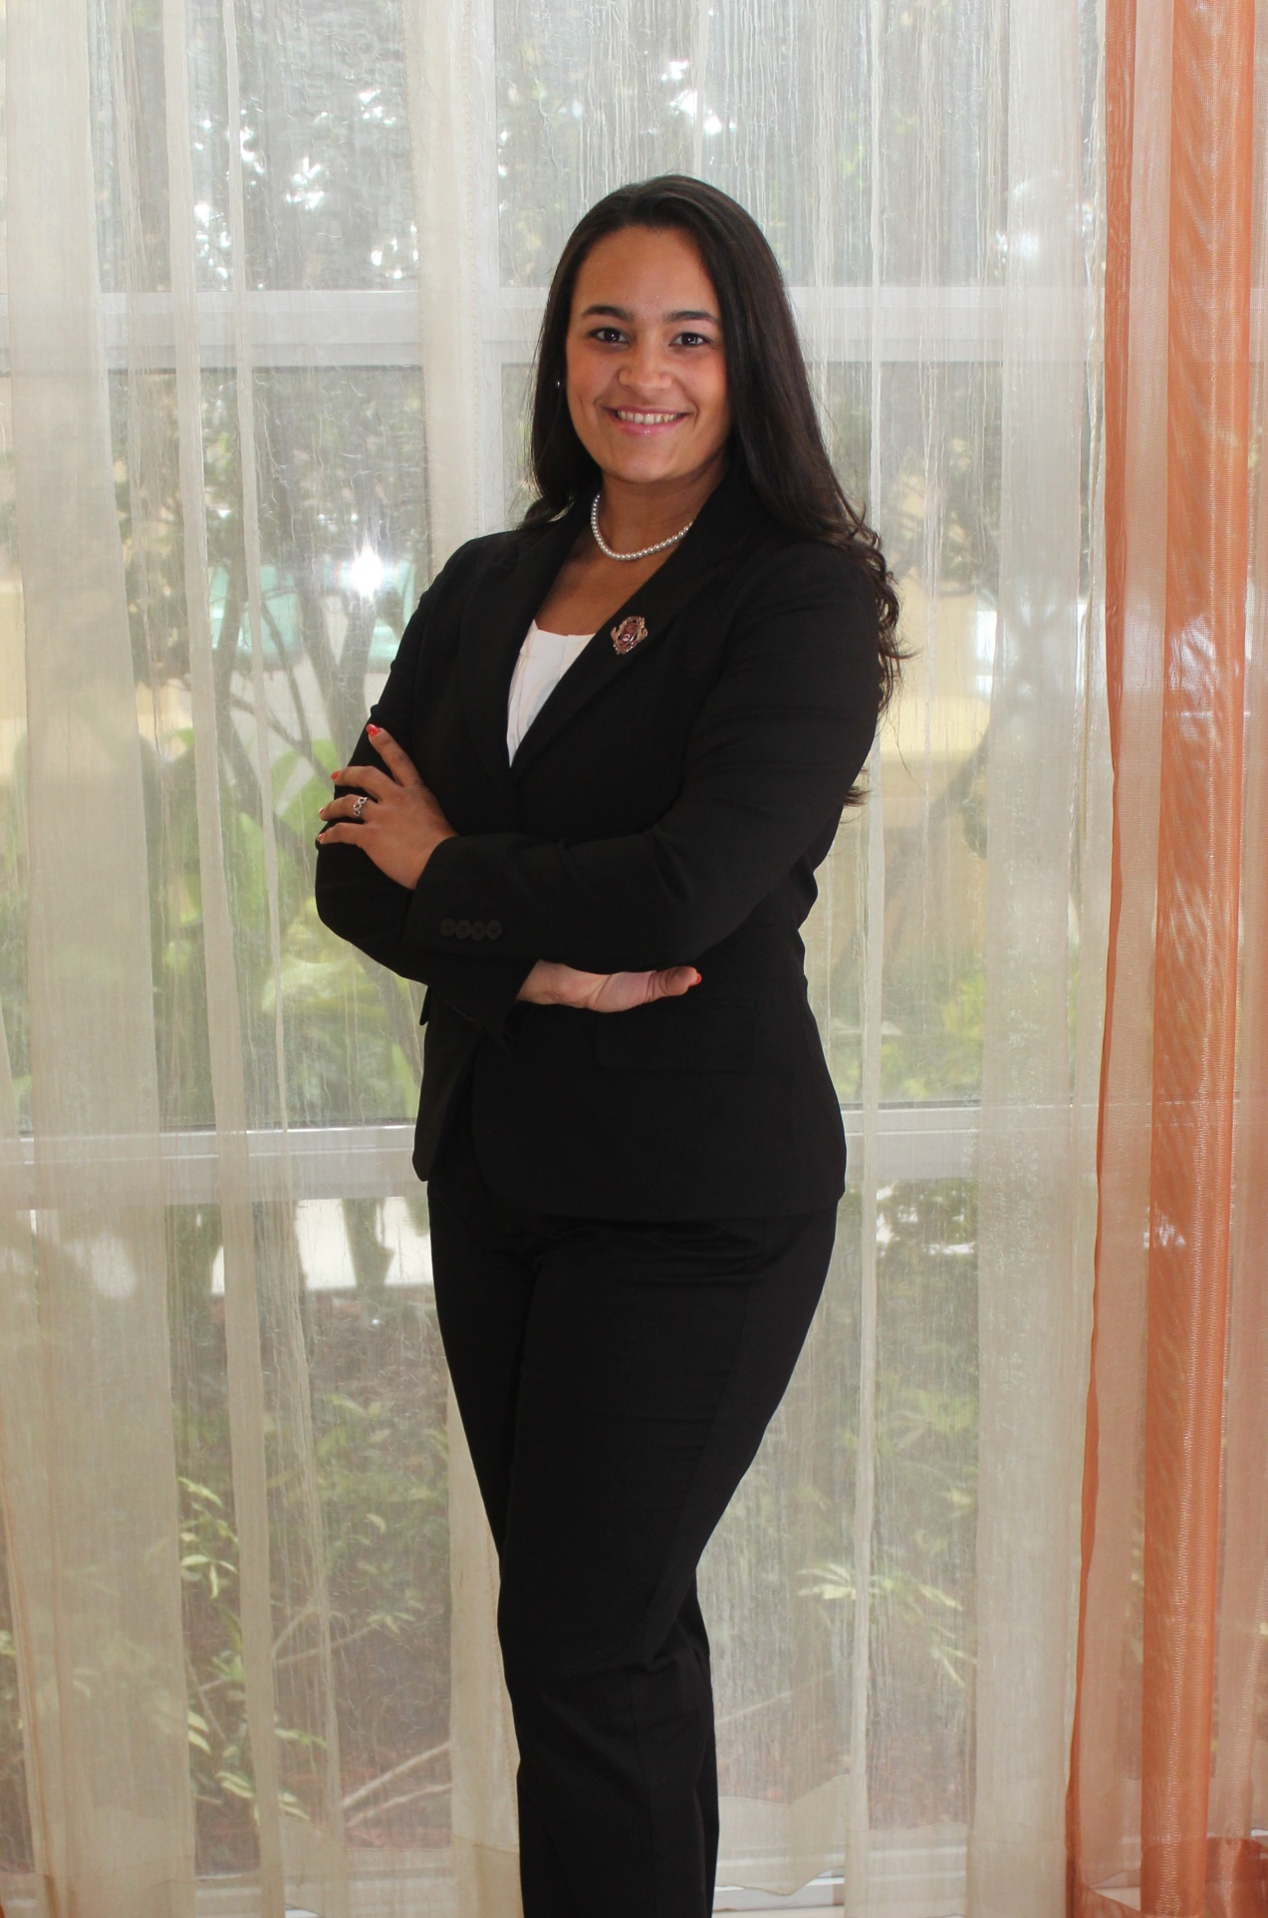
Denise Christina Vidot University of Miami Miller School of Medicine

Slide 31
2015 NIDA Director’s Travel Award Recipients

Slide 32
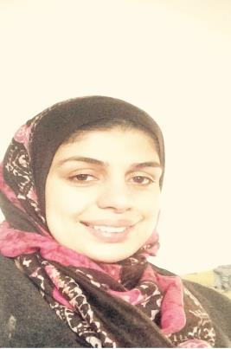
Omayma Alshaarawy, PhD Michigan State University

Slide 33
Lora Cope, PhD University of Michigan

Slide 34
Natania A. Crane, MA University of Illinois at Chicago

Slide 35
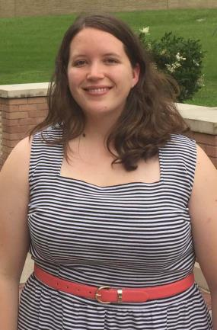
Elizabeth Crofton, BA University of Texas Medical Branch at Galveston

Slide 36
Casey Guillot, PhD University of Southern California

Slide 37
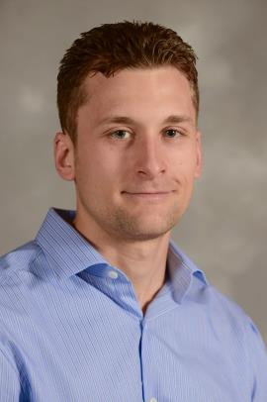
Bryce Hruska, PhD University of Vermont

Slide 38
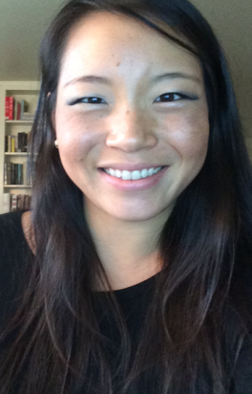
Jin E. Kim, PhD University of California, San Francisco

Slide 39
Pia Mauro, PhD Johns Hopkins Bloomberg School of Public Health

Slide 40
Raymond L. Moody, BA Hunter College

Slide 41
Maria Parker, MPH Michigan State University

Slide 42
Michael S. Placzek, PhD McLean Hospital, Harvard Medical School

Slide 43
Claudia Rafful University of California, San Diego

Slide 44
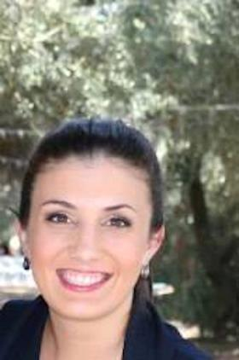
Kelly Serafini, PhD Yale University School of Medicine

Slide 45
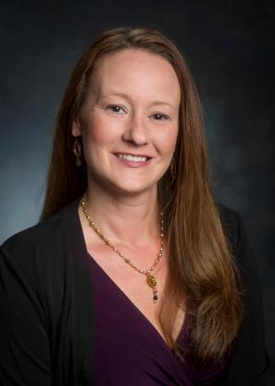
Kristi Stringer, MA University of Alabama at Birmingham

Slide 46
Olga Vsevolozhskaya, PhD Michigan State University

Slide 47
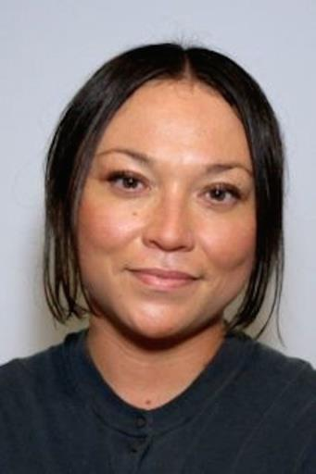
Sarah W. Yip, MSc, PhD Yale University

Slide 48
Ali M.Yurasek, PhD Brown University

Slide 49
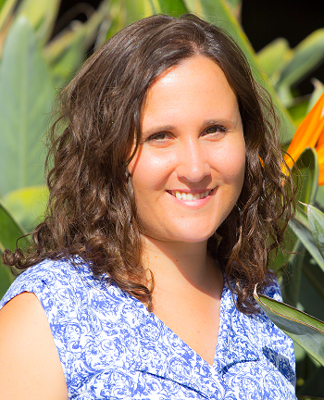
Meredith Meacham, MPH University of California, San Diego

Slide 50
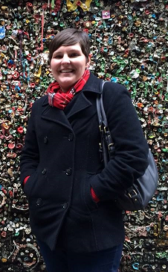
Lauren R. Pacek, PhD Johns Hopkins University School of Medicine

Slide 51
Olga Rass, PhD Johns Hopkins University School of Medicine

Slide 52
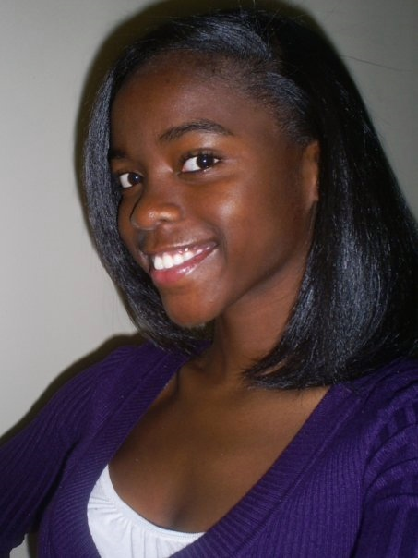
Chizara Ahuama-Jones
University of Cincinnati
Department of Clinical Psychology
NIDA Women & Sex/Gender Differences Research Junior Investigator Travel Awardee

Slide 53
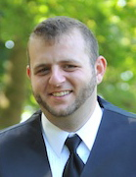
Christopher Arger
University of Vermont
Department of Psychiatry
NIDA Women & Sex/Gender Differences Research Junior Investigator Travel Awardee

Slide 54
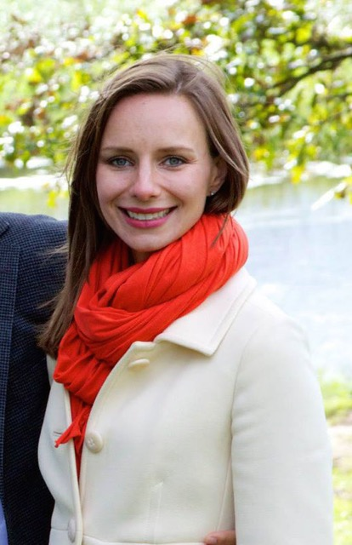
Katherine Belendiuk
University of California Berkeley
Institute of Human Development
NIDA Women & Sex/Gender Differences Research Junior Investigator Travel Awardee

Slide 55
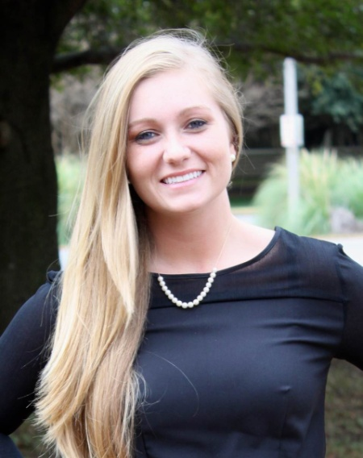
Stevie
Britch
Washington State University
Department of Psychology
NIDA Women & Sex/Gender Differences Research Junior Investigator Travel Awardee

Slide 56
Ayca Coskunpinar Byerley
Rush University Medical Center
Neuropsychology
NIDA Women & Sex/Gender Differences Research Junior Investigator Travel Awardee

Slide 57
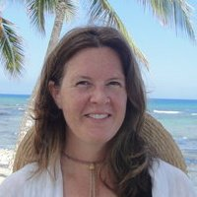
Elizabeth Evans
University of California
Los Angeles
Integrated Substance Abuse Programs
NIDA Women & Sex/Gender Differences Research Junior Investigator Travel Awardee

Slide 58
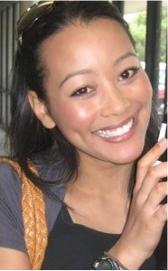
Dawn
Foster
Yale School of Medicine
Department of Psychiatry
NIDA Women & Sex/Gender Differences Research Junior Investigator Travel Awardee

Slide 59
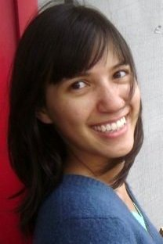
Helen
French
Hunter College
Department of Psychology
NIDA Women & Sex/Gender Differences Research Junior Investigator Travel Awardee

Slide 60
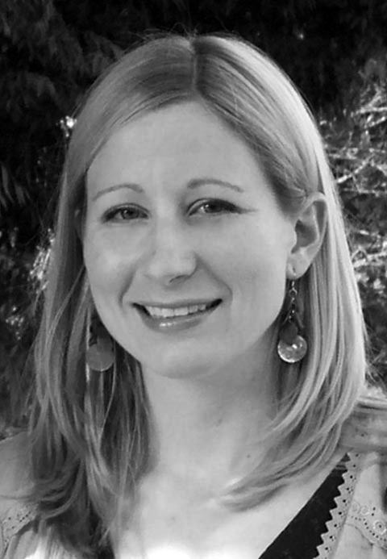
Jillian
Hardee
University of Michigan
Addiction Research Centers & Department of Psychiatry
NIDA Women & Sex/Gender Differences Research Junior Investigator Travel Awardee

Slide 61
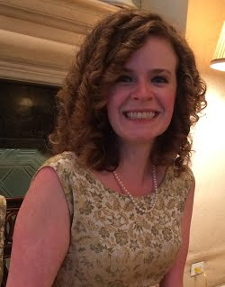
Emily
Hartwell
University of California
Los Angeles
Department of Psychology
NIDA Women & Sex/Gender Differences Research Junior Investigator Travel Awardee

Slide 62
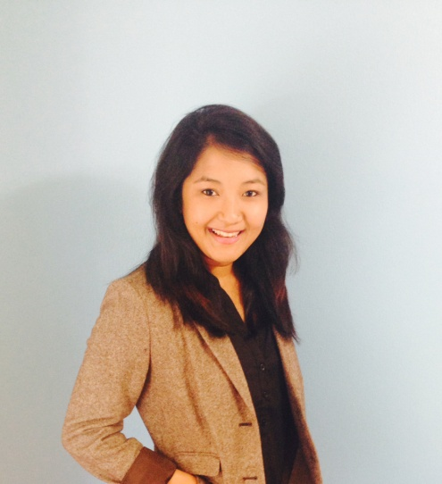
Shivani
Khan
University of Florida
Department of Epidemiology
NIDA Women & Sex/Gender Differences Research Junior Investigator Travel Awardee

Slide 63
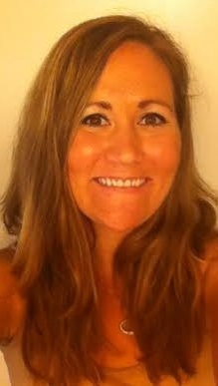
Sarah
Kromrey
Wake Forest University
Departments of Physiology and Pharmacology
NIDA Women & Sex/Gender Differences Research Junior Investigator Travel Awardee

Slide 64
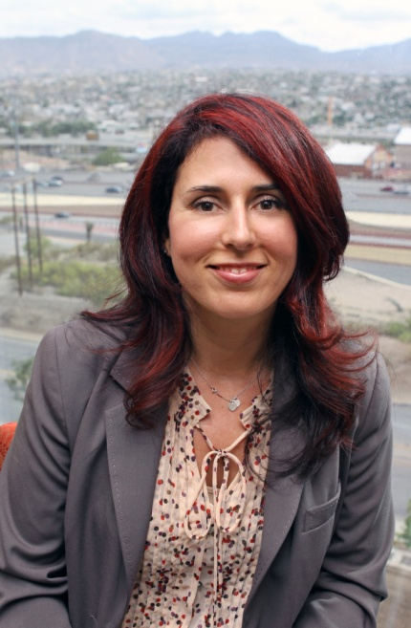
Oralia
Loza
University of Texas El Paso
Department of Public Health Sciences
NIDA Women & Sex/Gender Differences Research Junior Investigator Travel Awardee

Slide 65
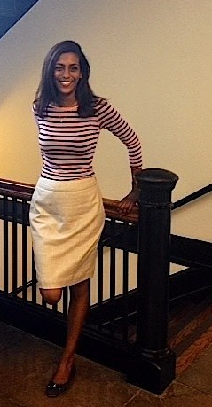
Vithya
Murugan
Washington University St. Louis
George Warren Brown School of Social Work
NIDA Women & Sex/Gender Differences Research Junior Investigator Travel Awardee

Slide 66
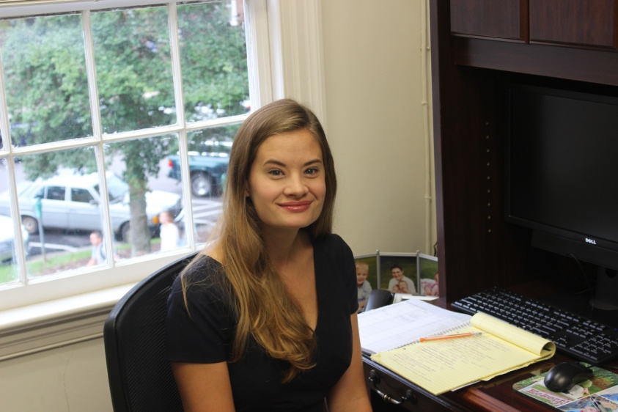
Kristen
Seay
University of South Carolina
College of Social Work
NIDA Women & Sex/Gender Differences Research Junior Investigator Travel Awardee

Slide 67
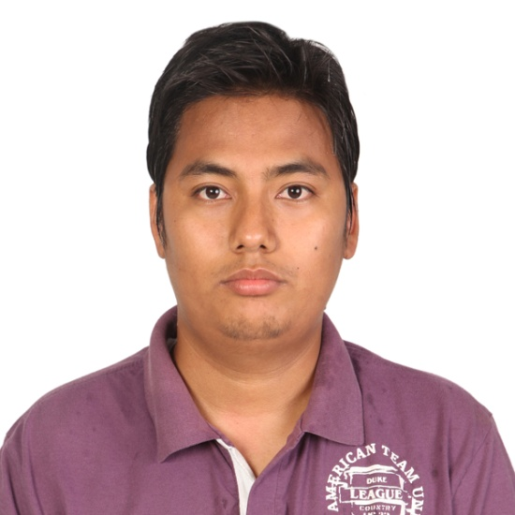
Roman Shrestha
University of Cincinnati
Department of Community Medicine and Health Care
NIDA Women & Sex/Gender Differences Research Junior Investigator Travel Awardee

Slide 68
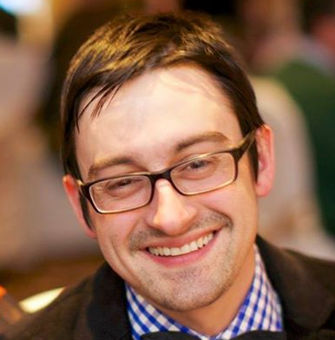
John
Smethells
University of Minnesota
Department of Psychiatry
NIDA Women & Sex/Gender Differences Research Junior Investigator Travel Awardee

Slide 69
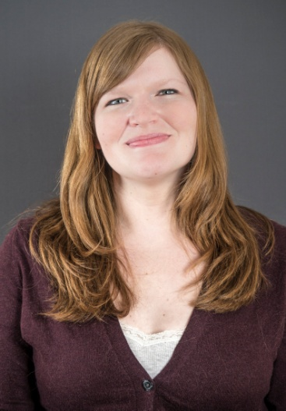
Natashia Swalve
University of Minnesota Department of Psychiatry
NIDA Women & Sex/Gender Differences Research Junior Investigator Travel Awardee

Slide 70
Virginia
Weiss
University of Kentucky
Department of Psychology
NIDA Women & Sex/Gender Differences Research Junior Investigator Travel Awardee

Slide 71
Kimberly Werner
Washington University Department of Social Work
NIDA Women & Sex/Gender Differences Research Junior Investigator Travel Awardee

